Slide 1
Court Attire For Female Attorneys and Witnesses: Professional
Acceptable Suit Colors:
Black
Navy
Gray

Slide 2
Clothing Items
Suit Jacket
Dress Pants/Skirt
Dress Top
Hosiery/Trouser Socks
Pumps/Flats
Simple Jewelry

Slide 3
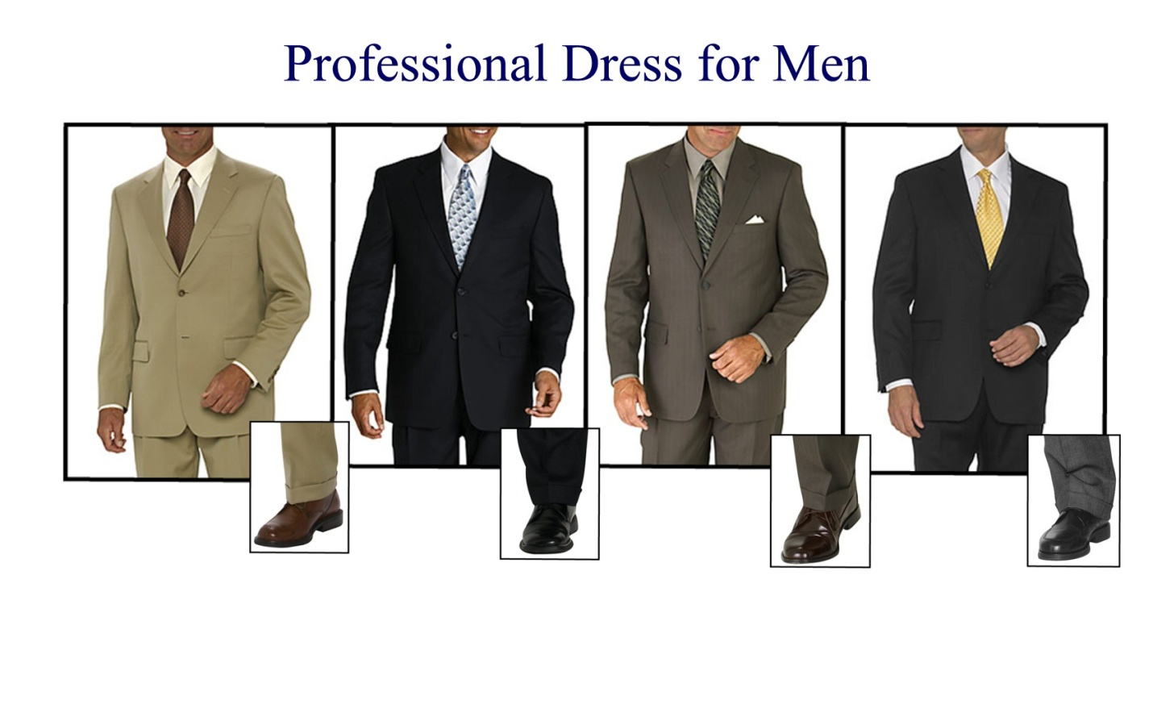
Court Attire For Male Attorneys and Witnesses

Slide 4
Clothing Items
Suit Jacket
Dress Pants
Collared/Button Down Shirt
Trouser Socks
Loafers or Dress Shoes
Tie/Bow-Tie

Slide 5
Grooming Tips
Do comb and brush your hair.
Do keep your nails clean.
Do make sure that your clothing is ironed/pressed and not full of wrinkles.

