Slide 1
Health Law Post-COVID-19: Evolving Federal Law to Enable Complex Care at Home
Shira Hollander, Director of Federal and State Strategy
March 24, 2023

Slide 3
Statutory and Regulatory Environment: Summary
History of Hospital at Home with CMS
While “hospital at home” models have been operating in the US for more than 20 years (pioneered and studied by Dr. Bruce Leff of John’s Hopkins Medicine), wider adoption only began to occur over the last 2-3 years.
As is typical with transformative efforts, clinical care innovation has happened at a faster pace with supporting reimbursement and regulatory frameworks lagging.
CMS’s support for the model through the Hospital Without Walls and Acute Hospital Care at Home Waivers in 2020 brought more attention and validation to the model as inpatient equivalent care, including inpatient DRG reimbursement.
Federal support exists under the PHE and through Dec. 31, 2024, thanks to the two-year extension included in the Consolidated Appropriations Act of 2023. That legislation will enable continued patient access to HaH for hospitals that apply (or have applied) and are approved for the waiver program. We expect CMS at some point to issue sub-regulatory guidance on implementing the extension (e.g., any change to application process).
State approval for hospital at home programs has been more varied. As such, MHG partners are operating under a variety of regulatory frameworks and licensure with the two most common being:
OP regulatory framework under physician group licensure for the telemedical command center services with each individual in-home component of the model operating under its respective licensure (i.e., home health licensure, paramedicine licensure, DME licensure, etc.)
Hospital regulatory framework and licensure where states have been explicitly supportive of the model waiving traditional conditions of participation (duration limited by legislation until Dec. 31, 2024)
Mount Sinai CMS Innovation Center Grant for 3-year program
2014
2017
PTAC submissions for Marshfield Clinic/Mount Sinai (physician-group focused)
Hospital Without Walls waivers for all CMS hospitals
March 2020
Acute Care at Home individual waivers for hospitals granted to those that apply and qualify
November 2020
Two-year extension of Acute Care at Home waiver signed into law
December 2022
May 2023
End of PHE and CMS Hospital Without Walls waivers
3

Slide 4
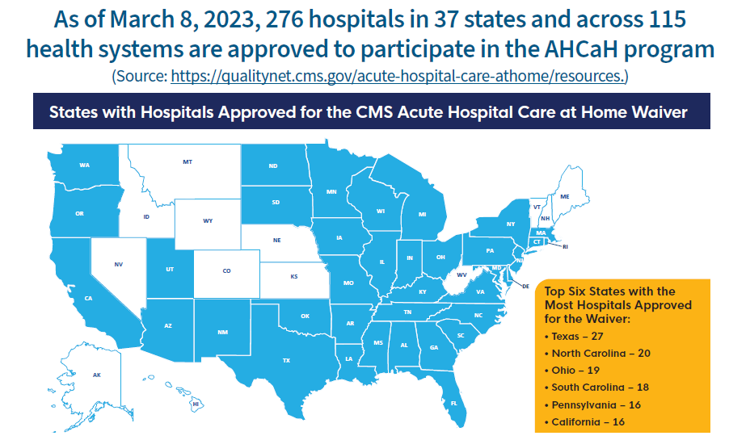
Broad Uptake of the CMS Acute Hospital Care at Home Waiver

Slide 5
CMS Acute Hospital Care at Home Waiver Requirements & Legislation
Necessary Services
Provide or contract for the following services:
Pharmacy
Infusion
Respiratory care including oxygen delivery
Diagnostics (labs, radiology)
Monitoring with at least two sets of patient vitals daily
Transportation
Food services (patients may decline in favor of their own food if clinically appropriate)
Durable Medical Equipment
Physical, Occupational, and Speech Therapy
Social work and care coordination
Additional Criteria
At least one daily MD/APP visit, which can be remote after the initial in-person History and Physical Exam performed in the hospital or ED.
At least two in-person daily visits by RN or MIH/CP. If both in-person visits performed by MIH/CP, additional daily remote RN visit to develop a nursing plan.
In-home appropriate emergency personnel response to a patient’s home within 30 minutes, if needed.
Must develop or use patient selection criteria.
Agree to voluntarily provide volume, escalation rate, and unanticipated mortality to CMS.
Establish a local safety committee (like Mortality and Morbidity team) to review reported metrics.

Slide 6
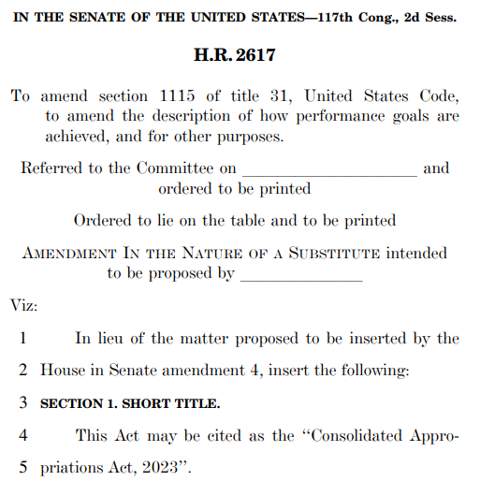
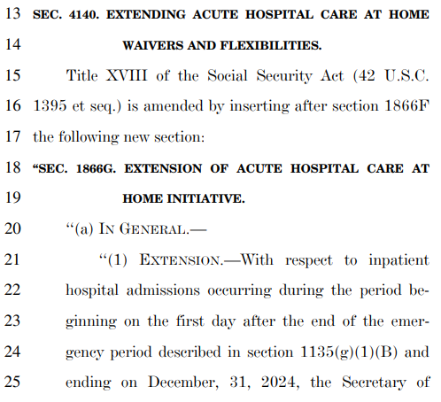
Consolidated Appropriations Act of 2023

Slide 7
Reporting Requirements / Report Topics of the CMS Acute Hospital Care at Home Waiver Legislation
‘‘(1) IN GENERAL.—The Secretary shall conduct a study to—
‘‘(A) analyze, to the extent practicable, the criteria established by hospitals under the Acute Hospital Care at Home initiative of the Secretary to determine which individuals may be furnished services under such initiative; and
‘‘(B) analyze and compare, to the extent practicable—
‘‘(i) quality of care furnished to individuals with similar conditions and characteristics in the inpatient setting and through the Acute Hospital Care at Home initiative, including health outcomes, hospital readmission rates, hospital mortality rates, length of stay, infection rates, and patient experience of care;
‘‘(ii) clinical conditions treated and diagnosis-related groups of discharges from the inpatient setting and under the Acute Hospital Care at Home initiative;
‘‘(iii) costs incurred by furnishing care in the inpatient setting and through the Acute Hospital Care at Home initiative;
‘‘(iv) the quantity, mix and intensity of such services (such as in-person visits and virtual contacts with patients) furnished in the Acute Hospital Care at Home initiative and furnished in the inpatient setting; and
‘‘(v) socioeconomic information on beneficiaries treated under the initiative, including racial and ethnic data, income, and whether such beneficiaries are dually eligible for benefits under this title and title XIX.‘

